Slide 1
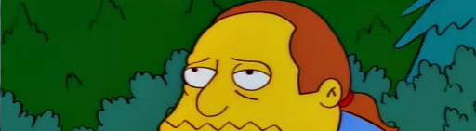
Project 6 What leads to good ratings on IMDB?
Byron Allen
Data Science Student at General Assembly
26 October 2016

Slide 2
Sentiment Scoring | Sum and Ratio

Slide 3
Poor Results & Changes to Binomial Dist.

Slide 4
Model Evaluation and Feature Selection

Slide 5
”Optimized” Models with Gridsearch

Slide 6
Model Performance

Slide 7
Next Steps
Re-do GridSearch
Use PCA and Compare Results
Experiment with Different TF-IDF and Sent Analysis
Move Away from Binary Values

